Slide 1



MJ
Human Resources
Analytics Dashboard
A Data-Driven View of Workforce Trends and Insights
Mirtunjay Kumar

Slide 2
MJ
Home
About Us
Content
Contact
HR
Objective
To analyze and visualize key HR metrics to enhance data-driven decision-making regarding employee retention, satisfaction, departmental performance, and compensation trends. This dashboard provides actionable insights into attrition rates, employee demographics, departmental satisfaction, average salaries by position, and performance distribution over time—helping HR teams optimize workforce management and strategic planning

Slide 3
🧾 Key HR Metrics at a Glance
MJ
Metric | Value | Insight
Attrition Rate | 28.30% | High attrition—requires retention strategy.
Average Salary | 69.02K | Competitive salary, useful for benchmarking.
Average EmpID | 10.16K | Indicates employee data scale.
Count of EmpStatusID | 311 | Reflects employment status types or transitions.
Sum of Absences | 3184 | Useful to assess attendance and productivity risks.
summary KPIs

Slide 4
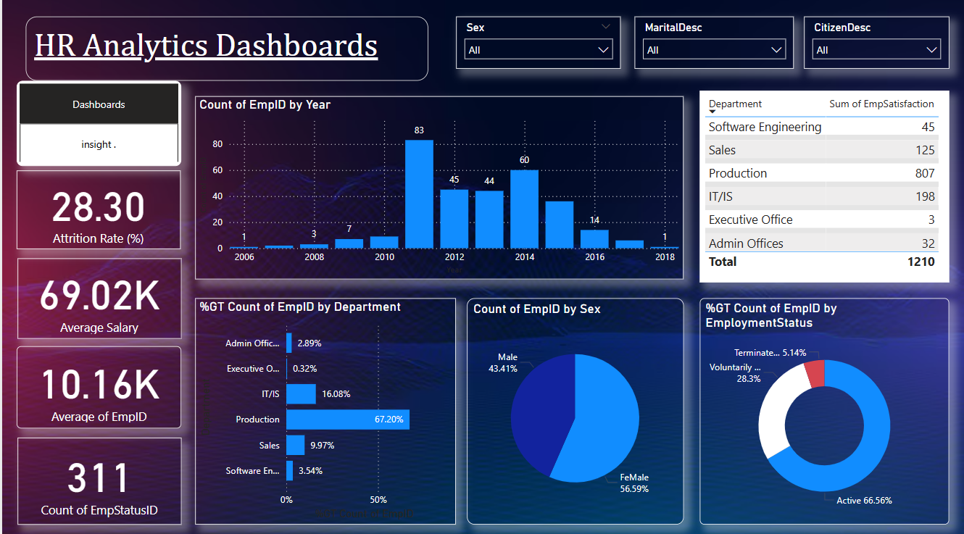

MJ

Slide 5
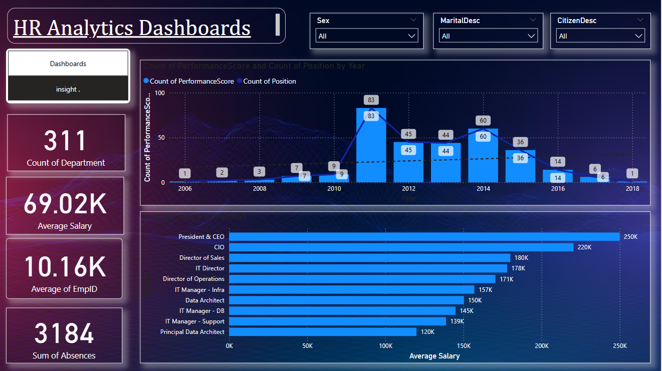

Slide 6

Recommendations
Reduce Attrition
Investigate causes in Sales/Production (high turnover + low satisfaction).
Implement retention programs (e.g., mentorship, career paths).
Address Pay Equity
Benchmark salaries by role (e.g., IT vs. Executive gaps).
Align with industry standards.
Optimize Workforce Planning
Analyze absence trends by department.
Target support for high-absence teams

Slide 7
MJ
Conclusion
The data highlights three key priorities: reducing the 28.3% attrition
rate, addressing salary gaps, and optimizing workforce planning.
By focusing on these areas, we can improve retention, ensure pay
equity, and boost productivity.
Let’s take action now to create a more engaged and stable workforce.

Slide 8



MJ
Thank You for Your Time
Future directions include a greater focus on employee well-being, diversity and inclusion, and adapting to remote and hybrid work models.
7979982592
Mirtun1999@gmail.com
https://www.linkedin.com/in/mirtunjay-kumar23/

